Slide 1

CMR COLLEGE OF ENGINEERING & TECHNOLOGY
Kandlakoya, Medchal, Hyderabad - 501401
Department of Computer Science and Engineering
Plant Species Recognition
Name of the student
G.Rohith Reddy-20H51A05E0
P.Arya Patel-20H51A05F3
D.V.Bhuvaneswar Reddy-20H51A05D9
Under esteemed guidance of
Mr.Ranjith Kumar

Slide 2
Outline
Abstract
Introduction
Literature survey
Existed system
- Problems in existed system
Design and Implementation
Problem Definition
Research work
- Proposed system architecture
- Methods
- Comparison of Proposed system with an existed system
Performance Measure
Results
Conclusion
Future Work
Notes:
2

Slide 3
Abstract
Notes:
3

Slide 4
ABSTRACT
Automatic identification and recognition of plant species in environments such as forests, mountains and dense regions is necessary to know about their existence. In recent years, plant species recognition is carried out based on the shape, geometry and texture of various plant parts such as leaves, stem, flowers, plant height etc. While modern search engines provide methods to visually search for a query image that contains a flower, it lacks in robustness because of the intra class variation among millions of flower species around the world.

Slide 5
INTRODUCTION
Notes:
5

Slide 6
Introduction
Plant species recognition has received a great attention from the machine learning and machine vision communities. There are many challenges that need to be overcome in order to have a reliable plant recognition method that could be used in serious industrial applications. . The process of manual taxonomy becomes time consuming and tedious when more and more images are added to the database. Automation of the recognition process can improve the time, efficiency, accuracy and cost associated with the recognition process. This has given rise to the demand of automatic tools for plant species recognition and classification.
Notes:
6

Slide 7
Literature Survey
Notes:
7

Slide 8
Existed system
Plant Taxonomy is a science to separate plants into similar groups based on the characteristics like color of the flower, shape of the flower, leaf shape and form, fruits, bark of the stem etc. Plant recognition when done manually by specialized taxonomists, suffers from perceptual biasness, cost of hiring of experts and shortage of experts. Automation of the recognition process can improve the time, efficiency, accuracy and cost associated with the recognition process .The current approaches for plant species identification utilize only leaf form and shape. The reason being that leaves due to their shape and size, have the advantage to be easily observed, captured and described and are less effected by seasonal changes.
Notes:
8

Slide 9
DESIGN AND IMPLEMENTATION
Notes:
9

Slide 10
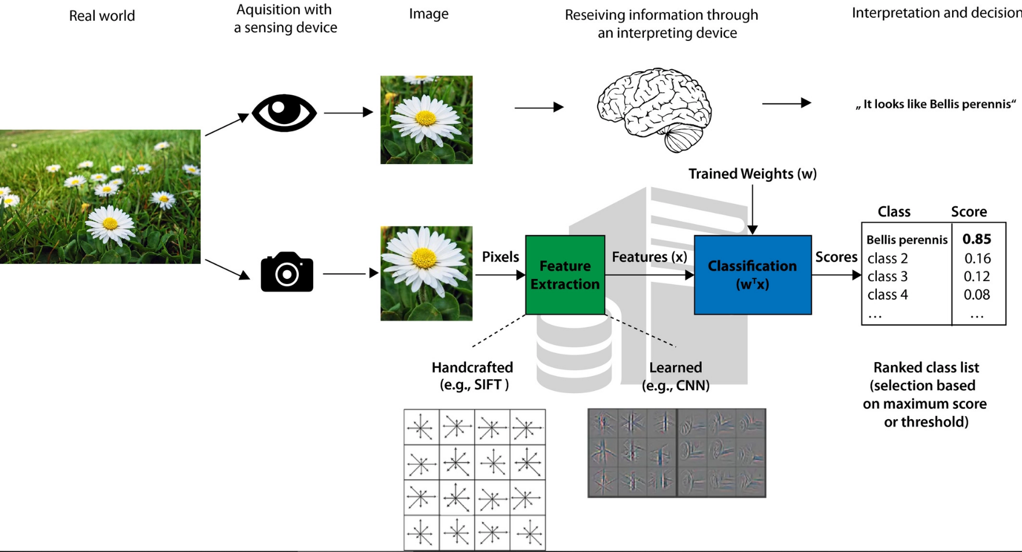
DESIGN AND IMPLEMENTATION

Slide 11
Problem Definition
Notes:
11

Slide 12
Problem Definition
Plants recognition system is mostly built using image processing techniques where the leaf is considered the main organ in the full plant structure.
Leaf, which contains important information about the plant to which it belongs, is used for species identification as well as for variety identification.
This project offers global significance in the field of plant species recognition. It can be used in forests, mountains and dense regions around the world to identify plant species in images greatly reducing the efforts for research work and easily identifying plant species.

Slide 13
Research Work
Notes:
13

Slide 14
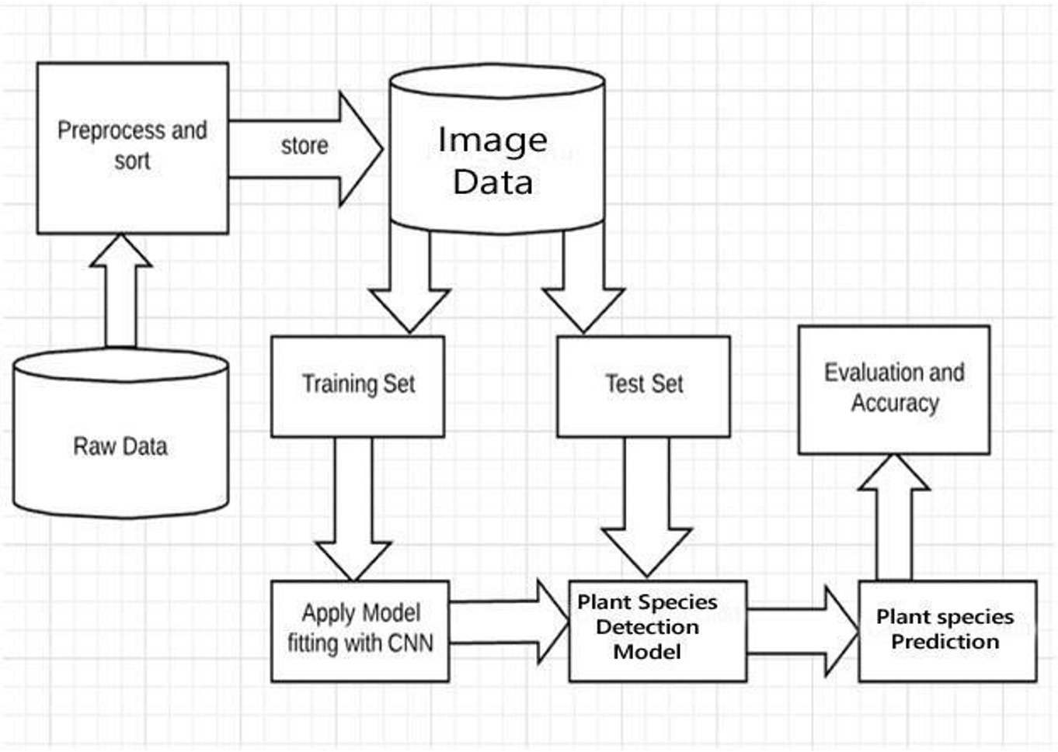
Proposed system architecture

Slide 15
Proposed Methods
The image data set is collected with different plant names then after that feature extraction is done .
Using deep learning we train to get new image and whenever new image is provided, we try finds new species of the plant.
This Prediction is done using Machine Learning.

Slide 16
Performance Measure:
Many metrics can be used to measure whether or not a program is learning to perform its task more effectively. For supervised learning problems, many performance metrics measure the number of prediction errors. There are two fundamental causes of prediction error: a model's bias and its variance. Assume that there are many training sets that are all unique, but equally representative of the population. A model with a high bias will produce similar errors for an input regardless of the training set it was trained with; the model biases its own assumptions about the real relationship over the relationship demonstrated in the training data. A model with high variance, conversely, will produce different errors for an input depending on the training set that it was trained with that is a model with high variance over- it's the training data, while a model with high bias under- ts the training data. It can be helpful to visualize bias and variance as darts thrown at a dartboard. Each dart is analogous to a prediction from a different dataset.

Slide 17
Result Analysis
The developed system is a basic approach at the problem of identification of plant species. The accuracy of the system can be improved upon to provide more accurate information about using other features. The code can also be turned into a python executable file such that it can be easily installed and used on any system.
To make this project highly efficient, other rare plant species and data images can be added to the dataset.By this the accuracy of the algorithm increases and training time of model decreases making the project more efficient.

Slide 18
Conclusion
Various techniques were used to predict the plant species in a metastatic image, based on visual observation and human experience, these predictions were often not very accurate. However, in recent years, with the advancement in technology, it has been possible to study metastatic images correctly using machine learning techniques namely Convolution Neural Networks and NasNet. In our Project we implemented these algorithms to predict the plant species by training the machine using a large dataset of collected metastatic scans and determined the roc curve for the best working algorithm

Slide 19
Future work
Instead, the image data set is collected with different plant names then after that feature extraction is done. Using deep learning we train to get new image and whenever new image is provided, we try finds new species of the plant. Thus, the prediction is done using Machine Learning.

Slide 20
References
1. https://www.analyticsvidhya.com/blog/2021/05/convolutional-neural-networksunderstand-the-basics/
2. https://towardsdatascience.com/a-comprehensive- guide- to-convolutional-neuralnetworks-the-eli5-way-3bd2b1164a53
3. https://ieeexplore.ieee.org/document/7411268
4.https://ieeexplore.ieee.org/document/7411268

Slide 21
Thank You!

